Slide 1
Hydrogen transport through 2D materials
Literature review
Devon Walker
devonw@andrew.cmu.edu
Kitchin Group @ CMU
2016-02-05

Slide 2
Motivation
Hydrogen transport through 2D materials Literature review
2D crystals have interesting properties and potential applications
Represents the smallest possible transfer barrier
Different combinations of electrical conductivity and proton permeability
Permeation can occur with several mechanisms
Notes:
Why would we want to do this
One atom thickness. Small separations devices
As we’ll see later, this can be manipulated to our advantage
2.1. Graphene - low proton permeation high electrical conductivity
2.2. Boron nitride - high proton permeation, electrical insulative
3. And it may possible to manipulate the crystal structures in order to facilitate different permeation selectivities.

Slide 3
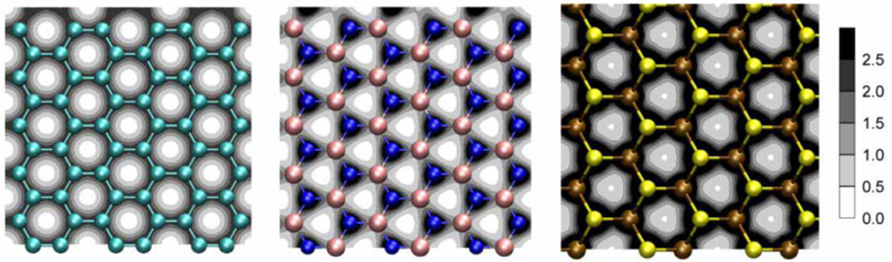
2D materials
Hydrogen transport through 2D materials Literature review
Graphene
hexagonal Boron Nitride (hBN)
Molybdenum Sulfide (MoS₂)
Electron cloud densities of 2D materials commonly found in literature.
1. Hu, S., Lozada-Hidalgo, M., Wang, F. C., Mishchenko, A., Schedin, F., Nair, R. R., … Geim, A. K. (2014). Proton transport through one-atom-thick crystals. Nature, 516(7530), 227–30. http://doi.org/10.1038/nature14015
Notes:
Most common materials from literature regarding 2D crystals.
It may not be so obvious by the holes, but atoms cannot penetrate these materials.

Slide 4
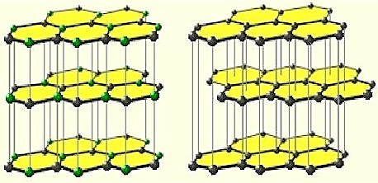
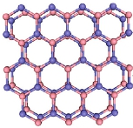
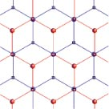
Multilayer structure
Hydrogen transport through 2D materials Literature review
AA stacking
(hBN)
AB stacking
(graphene)
1. Warner, J. H., Ruemmeli, M. H., Bachmatiuk, A., & Buechner, B. (2010). Atomic resolution imaging and topography of boron nitride sheets produced by chemical exfoliation. Retrieved February 4, 2016, from https://www.ifw-dresden.de/de/institute/institut-fuer-komplexe-materialien/abteilungen/mikro-und-nanostrukturen/molecular-nanostructures/boron-nitride/
2. Stack type image. (n.d.). Retrieved February 4, 2016, from http://www.a-m.de/englisch/lexikon/bornitrid-bild2.htm
3. Laboratoire de Physique des Solides - UMR 8502 - Twisted graphene bilayer in a magnetic field. (n.d.). Retrieved February 4, 2016, from https://www.lps.u-psud.fr/spip.php?article1930&lang=en
Notes:
If you’re familiar with graphite, the stacking principle is similar.
Boron nitride – directly on top
Graphene – offset centered on other electons. If atoms weren’t getting through before, they certainly aren’t now.

Slide 5
How does permeation happen?
Hydrogen transport through 2D materials Literature review
Proton permeation
“Electrochemical-pump”
Diffusion through defects
Larger molecule permeation
3. Diffusion through defects
Notes:
Protons flow through the materials due to a potential
Protons flow due to diffusion
Graphene oxide diffusion

Slide 6
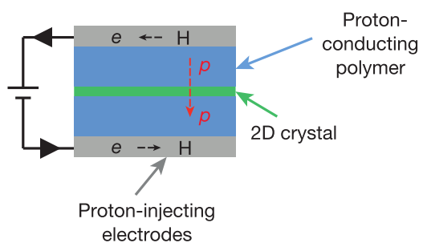
Hydrogen transport through 2D materials Literature review
1. “Electrochemical-pump”
Hu, S., Lozada-Hidalgo, M., Wang, F. C., Mishchenko, A., Schedin, F., Nair, R. R., … Geim, A. K. (2014). Proton transport through one-atom-thick crystals. Nature, 516(7530), 227–30. http://doi.org/10.1038/nature14015
Notes:
Paladium hydrogen electrode
Nafion

Slide 7
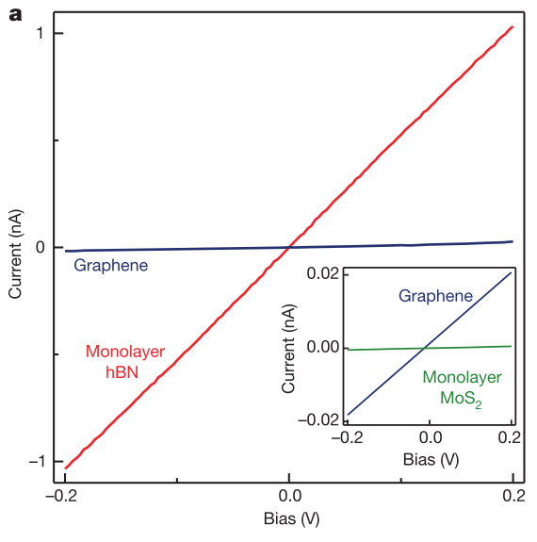
Hydrogen transport through 2D materials Literature review
Proton permeation through 2D materials
Hu, S., Lozada-Hidalgo, M., Wang, F. C., Mishchenko, A., Schedin, F., Nair, R. R., … Geim, A. K. (2014). Proton transport through one-atom-thick crystals. Nature, 516(7530), 227–30. http://doi.org/10.1038/nature14015
Notes:
hBN the most conductive

Slide 8
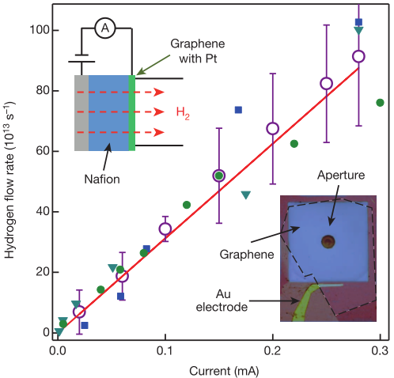
Current controlled transport with Pt
Hydrogen transport through 2D materials Literature review
Hu, S., Lozada-Hidalgo, M., Wang, F. C., Mishchenko, A., Schedin, F., Nair, R. R., … Geim, A. K. (2014). Proton transport through one-atom-thick crystals. Nature, 516(7530), 227–30. http://doi.org/10.1038/nature14015
Notes:
Graphene with Pt
No leak when there is no current
Analog control
hBN with Pt without charge
- Indistinguishable from bare hole device

Slide 9
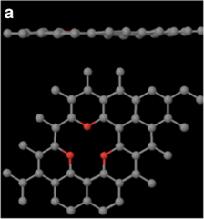
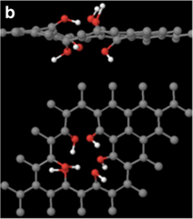
Hydrogen transport through 2D materials Literature review
2. Natural atomic defects in graphene
Ether termination
Hydroxyl termination
Achtyl, J. L., Unocic, R. R., Xu, L., Cai, Y., Raju, M., Zhang, W., … Geiger, F. M. (2015). Aqueous proton transfer across single-layer graphene. Nature Communications, 6, 6539. http://doi.org/10.1038/ncomms7539
Notes:
Monolayer graphene
Most likely to originate from the synthesis process or cosmic rays

Slide 10
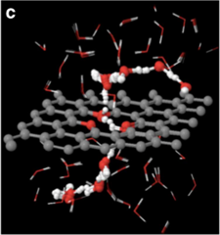
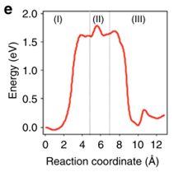
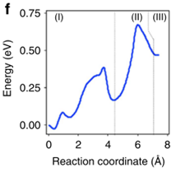
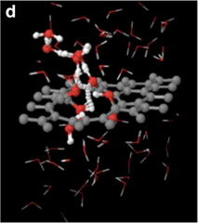
Proton transport in water through defects
Hydrogen transport through 2D materials Literature review
Ether termination
No proton transfer
Hydroxyl termination
Grotthuss relay mechanism
Achtyl, J. L., Unocic, R. R., Xu, L., Cai, Y., Raju, M., Zhang, W., … Geiger, F. M. (2015). Aqueous proton transfer across single-layer graphene. Nature Communications, 6, 6539. http://doi.org/10.1038/ncomms7539
Notes:
In aqueous solution. Water important
Ether termination: No protons transfer
Hydroxyl termination: Grotthuss-type (Grot-thuss) relay mechanism.
How to stop transfer? Bilayer

Slide 11
Grotthuss mechanism
Hydrogen transport through 2D materials Literature review
Agmon, N. (1995). The Grotthuss mechanism. Chemical Physics Letters, 244(5-6), 456–462. http://doi.org/10.1016/0009-2614(95)00905-J
https://en.wikipedia.org/wiki/Grotthuss_mechanism#/media/File:Proton_Zundel.gif
Notes:
Protons ‘hop’ across the boundary on the hydroxyl groups

Slide 12
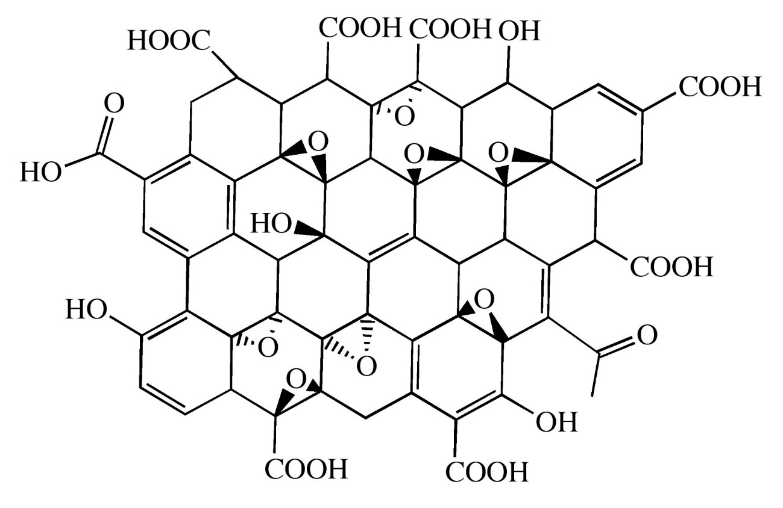
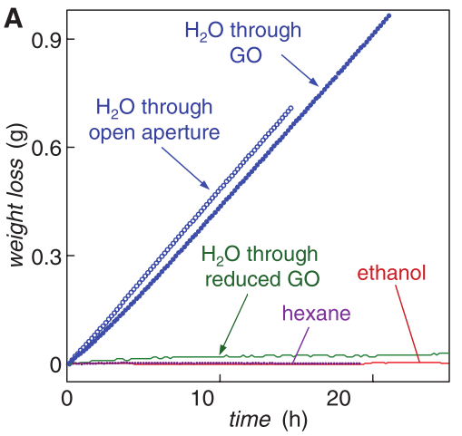
3. Graphene oxide water permeability
Hydrogen transport through 2D materials Literature review
Hamilton, C. E. (2009). Graphene oxide image. PhD Thesis, Rice University. Retrieved from http://archive.cnx.org/contents/790bacf3-6512-4957-bbed-ac887a4fca7c@4/graphene
Nair, R. R., Wu, H. A., Jayaram, P. N., Grigorieva, I. V., & Geim, A. K. (2012). Unimpeded Permeation of Water Through Helium-Leak-Tight Graphene-Based Membranes. Science, 335(6067), 442–444. http://doi.org/10.1126/science.1211694
Notes:
Builds on the previous defect diffusion
Prepared by oxidizing layers of graphite. Similar 2D crystal shape to graphene
Properties vary based on degree of oxidation
Water

Slide 13
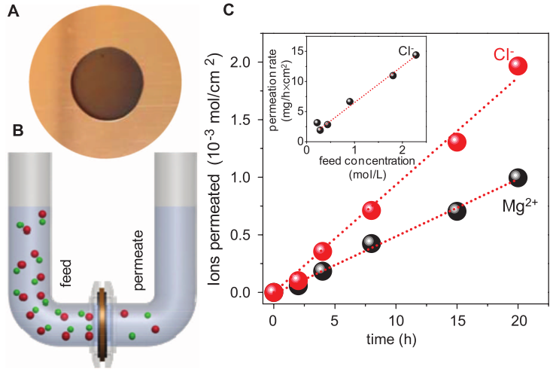
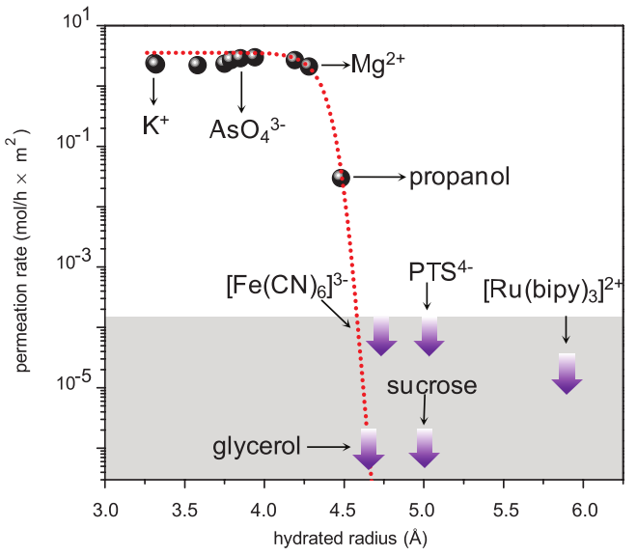
Large ion transport through graphene oxide
Hydrogen transport through 2D materials Literature review
Joshi, R. K., Carbone, P., Wang, F. C., Kravets, V. G., Su, Y., Grigorieva, I. V, … Nair, R. R. (2014). Precise and ultrafast molecular sieving through graphene oxide membranes. Science (New York, N.Y.), 343(6172), 752–4. http://doi.org/10.1126/science.1245711
Notes:
Steep dropoff around a radius of ~4.5 Angstroms

Slide 14
Remaining questions
Hydrogen transport through 2D materials Literature review
Can neutral atoms, like hydrogen, be permeated through a 2D crystal?
Is it possible to achieve selective permeation with multilayer 2D crystals?
Notes:
The eletron may pose a problem. Can we briefly turn it into a proton till it passes through?
Graphene oxide-like permeation ideas to selectively pass larger geometric molecules. Can we think of ways of engineering defect sites to achieve this?

Slide 15
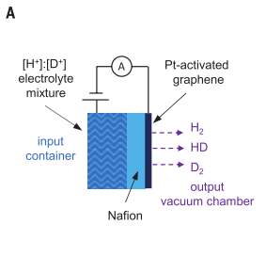
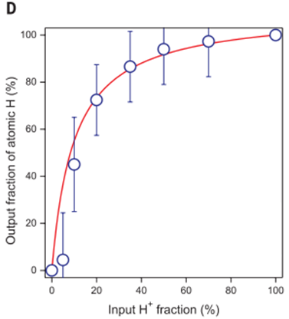
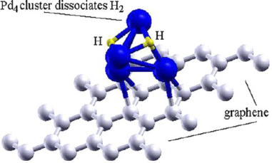
Supplemental material
Hydrogen transport through 2D materials Literature review
Even more information available on Github.* https://github.com/devonwa/hydrogen2D
Isotope separations
Palladium on graphene
Cabria, I., López, M. J., Fraile, S., & Alonso, J. A. (2012). Adsorption and Dissociation of Molecular Hydrogen on Palladium Clusters Supported on Graphene. The Journal of Physical Chemistry C, 116(40), 21179–21189. http://doi.org/10.1021/jp305635w
Notes:
I don’t know how to share the private repo with the group yet.

